Slide 1
AIRLINES MANAGEMENT SYSTEM
REPRESENTED BY:
ZAINAB KHAN (FA22-BSE-032)
MANAHIL TARIQ (FA22-BSE-050)
ANUM HAMEED (FA22-BSE-048)

Slide 2
MAIN FEATURES:
User Registration and Login
View Available Flights
Book a Flight
Logout after booking
Responsive user-interface

Slide 3
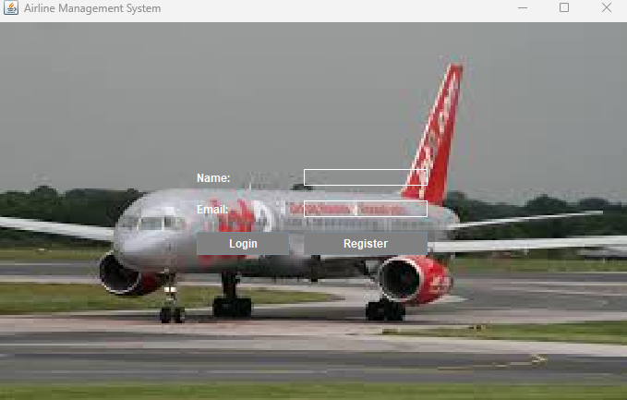

Slide 4
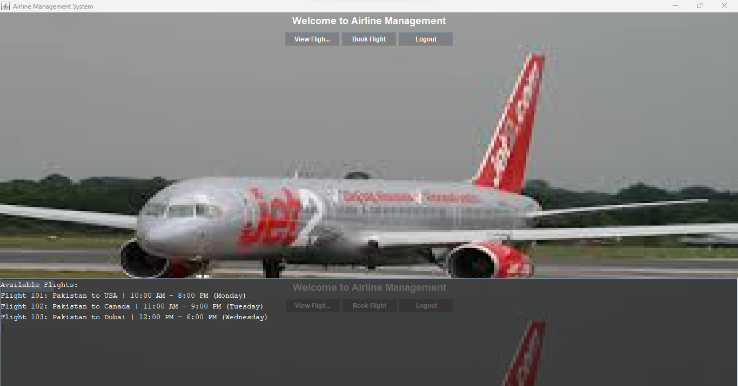

Slide 5
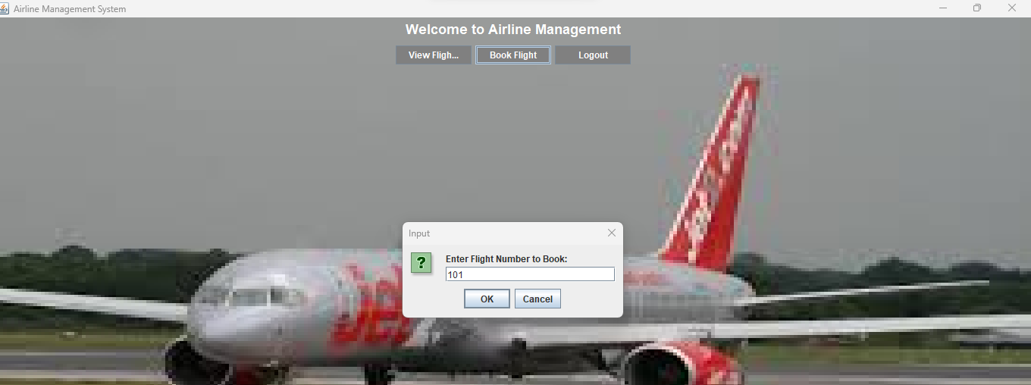

Slide 6
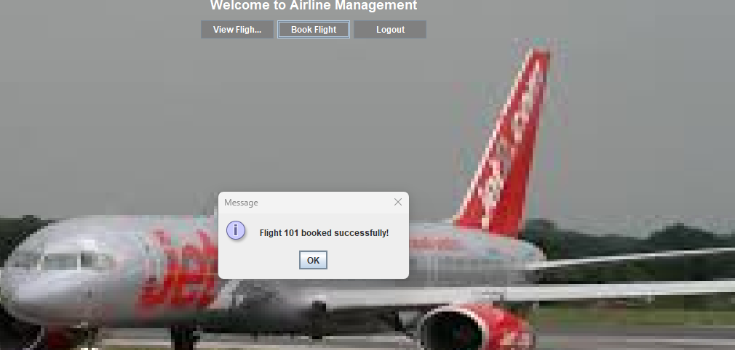

Slide 7
REQUIREMENTS MAPPING :
User-Side Scope:
Account registration and login with email validation.
Viewing available flights.
Booking flights by entering valid flight numbers.
Receiving confirmation messages after successful bookings.
Logout functionality.

Slide 8
TECHNOLOGY USED:
Programming Language: Java
UI Framework: Java Swing
IDE: IntelliJ / NetBeans / Eclipse
AI Tools: ChatGPT

Slide 9
AI-TOOL USAGE SUMMARY:
Tool Used: ChatGPT
Usage:
UI design improvements (transparent panels, styling)
Class structure and method design suggestions
Documentation
Prompts example:
“How to structure flight booking with classes?”
“How to design login and register functionality?”

Slide 10
CONCLUSION
Changes from Design:
Used Background Panel for UI aesthetics
Simplified flight booking by input dialog instead of new screen
AI Tool Benefits:
Helped with layout logic and Java UI component behavior
Time-saving for syntax and structural patterns
Confusion or Limitations:
AI suggestions required manual tweaking for Swing events
What We’d Do Differently:
In Feature we can add:
Add database integration for persistence
Include seat availability and payment modules

Slide 11
Thank you!

